Slide 1
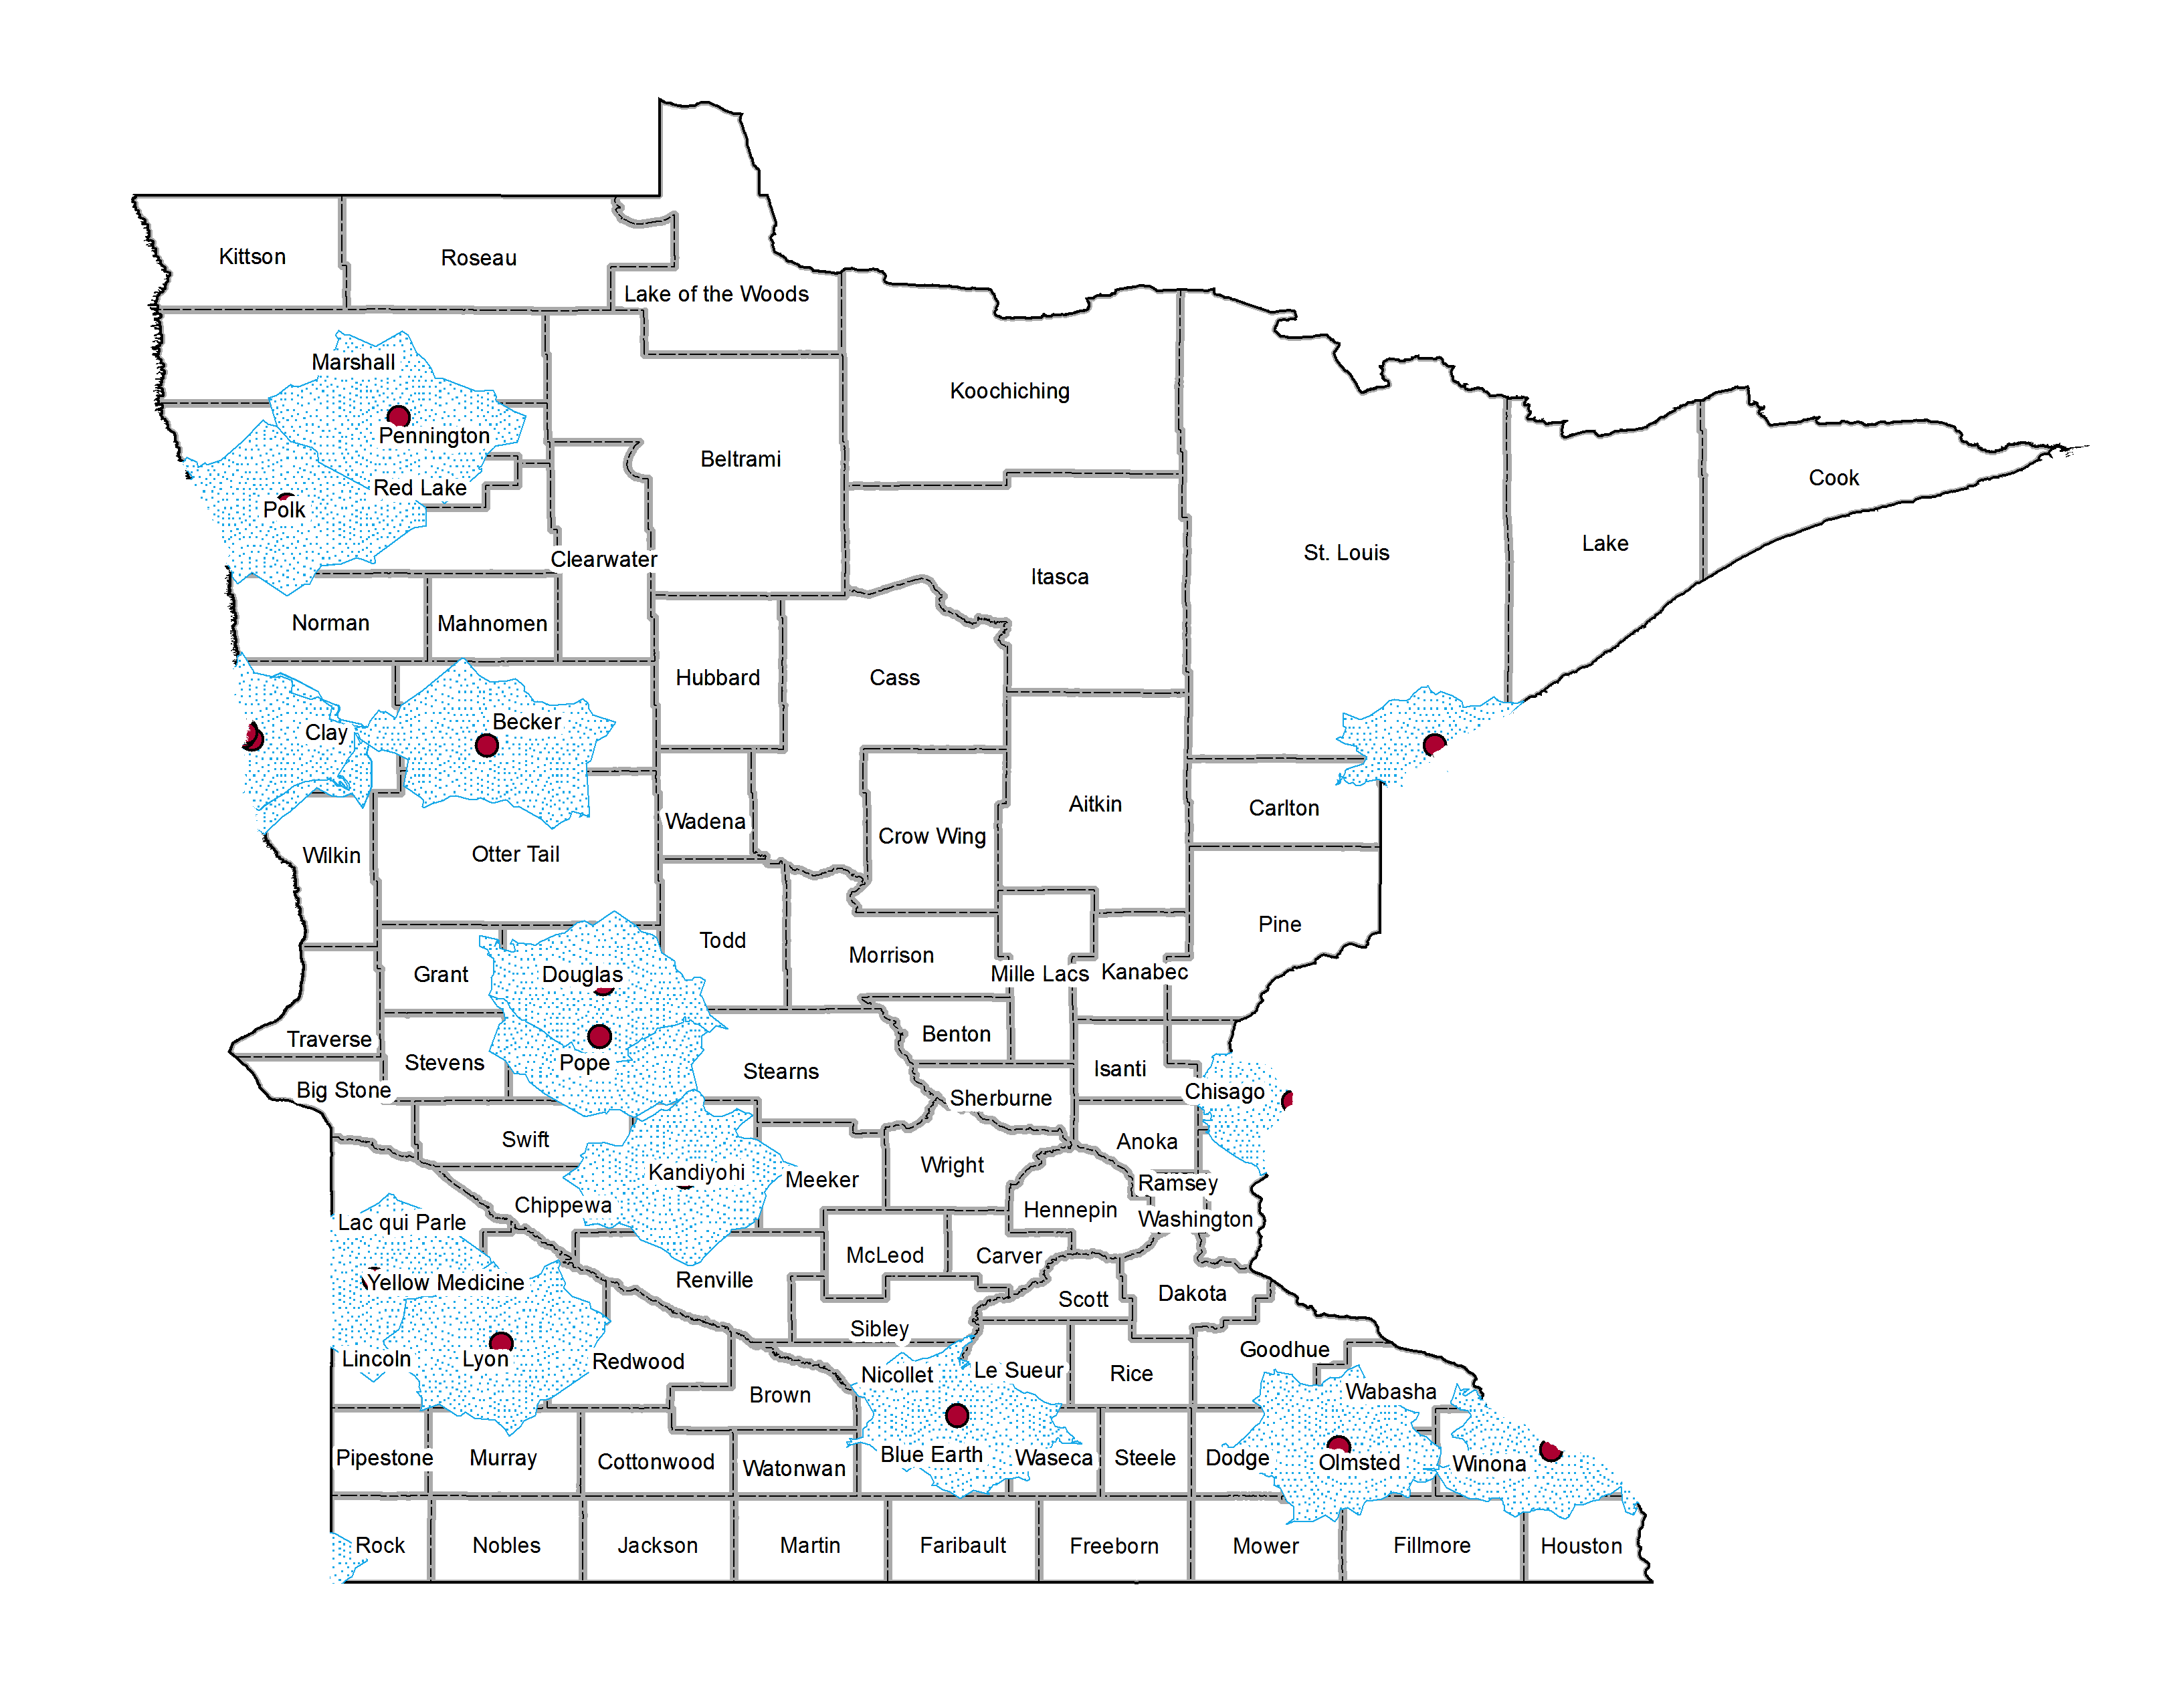
Evaluation of Minnesota Health Insurance Network Adequacy
Jil Pavagadhi and Jennifer Schultz
abstract
methods
results
The goal of the Affordable Care Act (ACA) is to increase access to health insurance and health care services and yet after spending close to $3 trillion many residents have limited access to health care providers.
Data is publically available and self reported by insurance companies; requested from the Department of Health
Data standardization and analysis
37 insurance plans for the year of 2017
Excel
Mapped and drew out 30 min/mile polygons
700- 78,000 provider locations per plan
With about 98-100% precision
ArcGIS
The coverage percentage is the average number of people covered per specialty/type divided by census population (people supposedly covered by that specific insurance plan)
Table 2: The availability of services and the number of people actually covered in the plan
Plan | Availability | Coverage
BCBSAware17 | neuropsychology not available | 94.0%
BPAllinaHealthNetwork17 | neuropsychology not available | 96.8%
BPGroupValueNetwork17 | neuropsychology not available | 94.1%
BPMayoClinicHealth17 | neuropsychology not available | 87.4%
BPSanfordHealth Network17 | neuropsychology not available & chemical depend. provider (inpatient) not available | 67.2%
GSGGundersenSmall Group17 | child psychiatry not available | 38.2%
background
Table 1: Provider types and specialties researched
US spends 17% of the GDP on health care, approximately $3 trillion
Minnesota contributed about $39.8 billion in 2012 (MN Dept. of Health)
Access is limited to persons with
Insurance through the employer/exchange (online marketplaces where persons may purchase & receive subsidies for the purchase of insurance)
Government sponsored program (Medicare, Veteran Affairs)
Purchase private insurance/care
Safety-net providers (facilities that provide significant level if care to low-income, underserved, vulnerable, population and people of color)
Narrow Network plans are becoming popular (50% of marketplace offerings)
Drive down overall cost of healthcare
Lower premiums
Plans too narrow to offer care in a timely manner with additional issues (22%)
Decreasing over time (2015- 15 network providers → 2017- 12)
Minnesota geographic access standards
Max travel of either 30 minutes/miles for primary care, mental health, & general hospital services
In certain situations when a provider network is not able to meet the geographic access requirement, a carrier may apply for a waiver
RESEARCHED PROVIDERS
child psychiatry
psychiatry
neuropsychology
mental health nurse practioner & mental health clinical nurse specialist
licensed independent clinical social worker
licensed psychologist
licensed professional clinical counselor (LPCC)
chemical dependency provider- inpatient
chemical dependency provider- outpatient
Table 3: Number of people supposedly covered in total and per service according to the plan
Plan | num. of people supposedly covered | child psychiatry | psychiatry | neuro psychology
BCBSAware17 | 5303925 | 4616214 | 5167840 | NA
BPAllinaHealthNetwork17 | 3481431 | 3438080 | 3462957 | NA
BPGroupValueNetwork17 | 4619058 | 4006513 | 4473985 | NA
BPMayoClinicHealth17 | 652816 | 472964 | 632069 | NA
BPSanfordHealthNetwork17 | 621419 | 340908 | 542146 | NA
GSGGundersenSmallGroup17 | 360302 | NA | 218012 | NA
results
~41% of plans are insufficient (15/37)
HealthPartners, Medica, Sandford Health plans provide all types of services
Many plans did not have spec 21 and 81 available (spec 21 matched to child psychiatry and spec 81 to neuropsychology)
Waivers must have been approved for the unserved areas.
Conclusion & Future WORK
First time the data has been cross checked by a 3rd party
Network inadequacy is clearly visible
Causes concern for the undiagnosed patients
Networks are constantly decreasing
Possible reasons:
Insufficient mental health providers in Minnesota
Plans reimbursement levels to MH providers may be too low, thus providers not willing to participate in networks
Continue research with dental insurance plans
Conduct research on other specialty & provider types
Improve network adequacy requirements & audit carriers
objectives
Image 1: Child psychiatry providers/clinics outside the metropolitan
To evaluate the health insurance network adequacy in Minnesota for specific “Provider Specialties” (21, 23, 81, 82) and several “Provider Types” (14, 42, 63, CD1F, CD2F).
The analysis will provide information to Minnesota agencies and state legislators with regard to network adequacy and whether health plans operating in Minnesota comply with state and insurance regulations.
This will inform policy makers on the need to strengthen insurance regulations.

